Slide 1

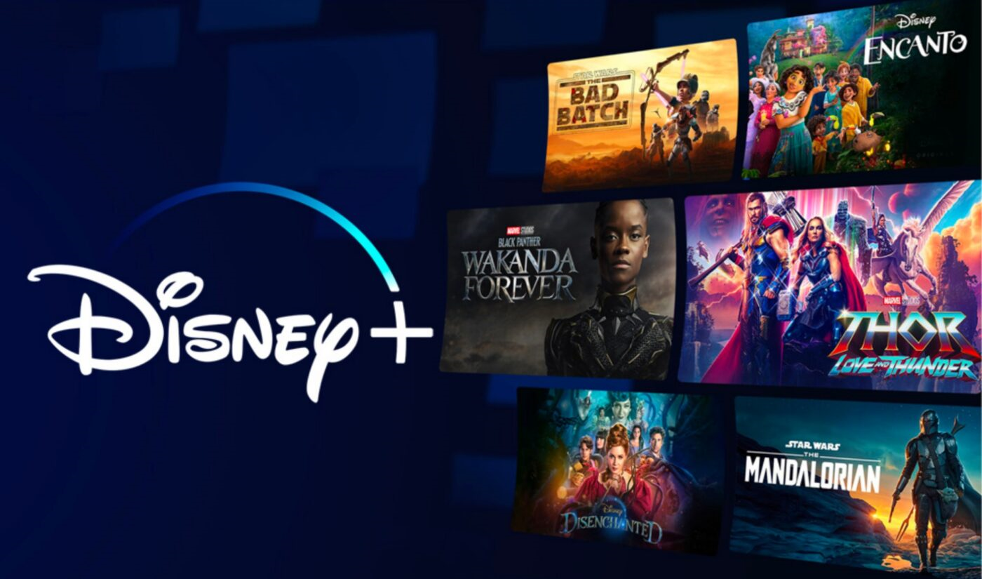
Chin-Chin Lin, Ruicheng Li, Mathias A. Riegg, Nora Bayaa, Lalitha P. Bhupalam,
Jason Chang, Lorena Morales

Slide 2
Overview of Disney DTC: A Legacy of Storytelling & Innovation
Disney DTC
Titan of storytelling and innovation
Renowned for streaming services: ESPN+, Disney+, Hulu
Digital Era Adaptation
Merging traditional storytelling with digital trends.
Engaging global audiences with evolving preferences.
Rich Content Library
Over 500 films and 15,000 TV episodes
Testament to Disney's magical storytelling
Legacy and Market Position
Maintaining a revered legacy in a dynamic market
Continuously adapting to meet changing consumer demands
Awards and Successes
22 Academy Awards
Substantial success in 2023

Slide 3
Strategy
Iger’s new content strategy is “cash content spend reduction target” of $4.5 billion, expects to spend $25 billion on content in 2024, down from $27 billion from fiscal 2023. This will take a few years for the bulk of the savings to be reflected in the P&L. 40 percent of Disney’s content budget allocation is on sports and sports content and 60 percent on Entertainment. This is equivalent to $10 billion on sports, and $15 billion on entertainment in 2024.

Slide 4
Market
Market Growth
Streaming market projected to reach $697.2 billion by 2025-2030.
Annual growth rate (CAGR) of 19.5%.
Growth Drivers
Advances in technology.
Decline of traditional cable services.
Rising demand for on-demand, high-quality, and diverse content.
Competitive Landscape
Highly competitive with rapid innovation.
Disney+ stands out with over 130 million subscribers.
Challenges
Facing stiff competition from industry leaderNetflix with a market valuation of $258 billion.
Recent subscriber dip from 161.8 million to 149.6 million.
Strategic Response
$25 billion investment in content to enhance brand appeal and financial performance.
Aim: Strengthen Disney DTC’s position as a leader in the entertainment industry.

Slide 5
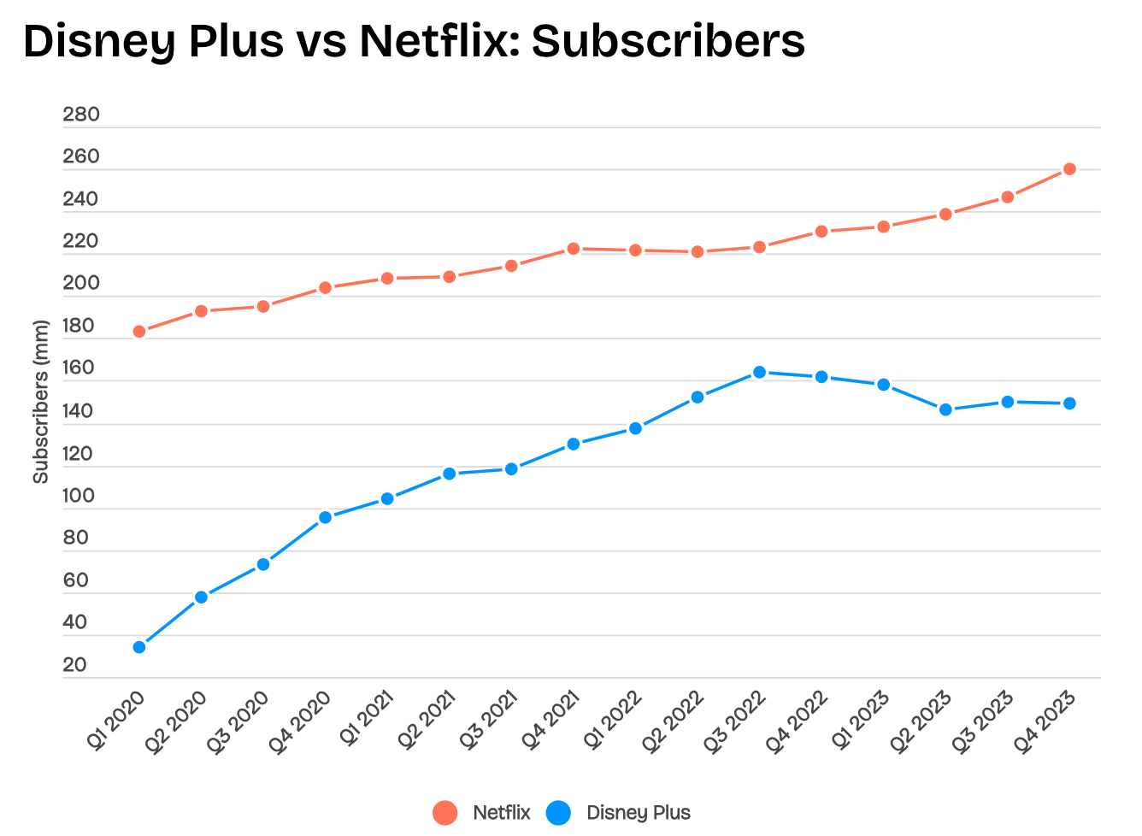
Streaming Market Dynamics & Disney DTC’s Strategic Position
The streaming video market is burgeoning, projected to hit $697.2 billion by 2025-2030, with a 19.5% CAGR,
Disney boasts 149.6 million subscribers, while Netflix leads with over 260 million.
Netflix's market valuation stands at $258 billion, surpassing Disney's $200 billion.
To remain competitive, Disney has committed $25 billion to content investment.

Slide 6
Streaming Market Dynamics
Gate 5
Gate 4
Gate 3
Market
Growth
Launch
The streaming video market is burgeoning, projected to hit $697.2 billion by 2025-2030, with a 19.5% CAGR
Analysis
Review
Mercury is the closest planet to the Sun
Development
Neptune is the farthest planet from the Sun
Saturn is a gas giant and has several rings
Jupiter is a gas giant and the biggest planet

Slide 7
Competition

Slide 8
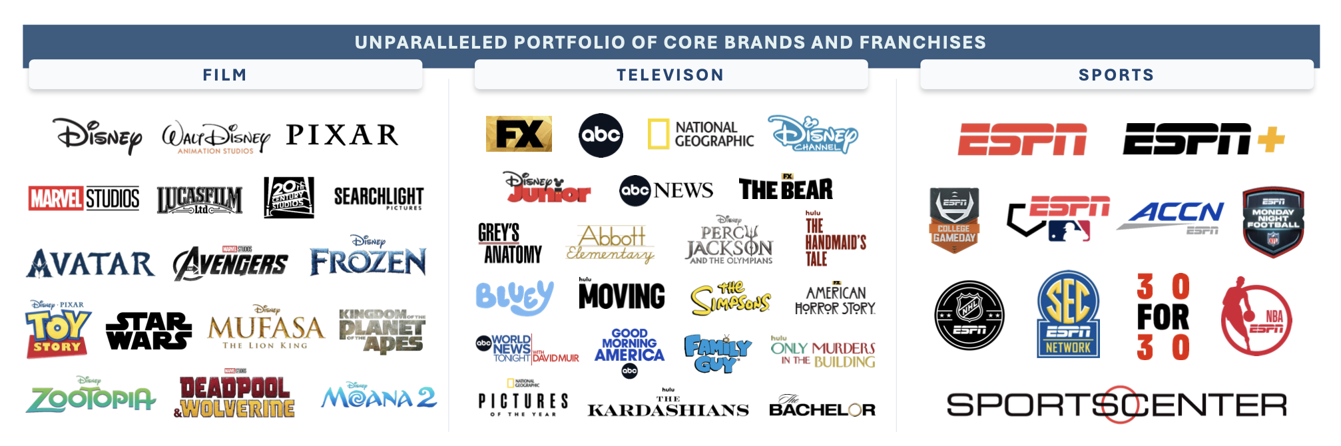
Market
Disney is concentrating on its main brands and franchises to enhance profitability.
Its franchises are noted for their enduring appeal and Disney's unmatched capacity to engage consumers through its diverse portfolio.
In an effort to elevate quality, Disney has scaled back its content production, focusing on fewer, higher-quality projects.

Slide 9
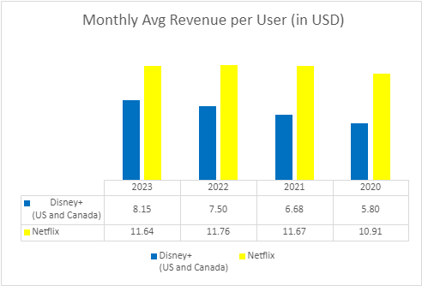
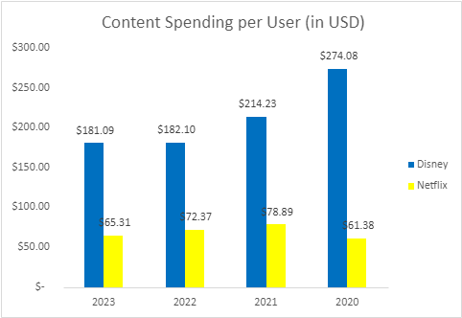
Statement of Concern
Despite an upward ARPU trend within North America, Disney+’s subscriber base has contracted, starkly contrasted by Netflix’s climb to over 260 million subscribers by Q4 2023.
Such trends compel a strategic reassessment to invigorate subscriber numbers and elevate ARPU, which trails Netflix’s $11.64.
Disney's content investment per user is substantially higher than Netflix's (Appendix 4), necessitating a strategic optimization to bolster content efficiency and fulfill the audience's appetite for originality.
On the content and IP front, Disney's expenditure on four underperforming movies signals a need for a refreshed creative direction and the curation of new IPs, moving away from an over-reliance on franchises that risk audience fatigue.
This strategic balance aims to rejuvenate our portfolio, align with market expectations, and solidify Disney DTC's standing and fiscal vitality within the streaming landscape.

Slide 10
Transformation Hypothesis

Slide 11
Outline of the main strategy behind the transformation.
Elevating Disney DTC: Strategic Commitment for Growth & Innovation
Slide Content:
CEO’s Commitment
Unprecedented growth, efficiency, and superior competitive stance.
Market Transformation
Target the 16-34 demographic to drive growth.
Leverage ESPN's digital presence for subscriber and revenue boost.
Preserve and enhance the allure of sports content.
Product Transformation
Revitalize content slate with innovative IPs and beloved franchises.
Stimulate fan engagement, particularly among digital natives.
Refine user experiences and tailor content for global audiences.
Implement flexible pricing models to address content saturation and price sensitivity.
Digital Transformation
Expand ESPN's digital outreach.
Forge partnerships in gaming and AR/VR to unlock new revenue channels.
Ensure long-term sustainability and growth in the digital landscape.

Slide 12
Strategies Commitment and Frameworks
Thought Oriented
People Oriented
Action Oriented
Monitor
Team Worker
Complete
Despite being red, Mars is a cold place
Venus has a very beautiful name
Neptune is the farthest planet
Specialist
Resource Investigator
Implementer
Saturn is the ringed one. It has rings
It’s the closest planet to the Sun
It’s a gas giant and the biggest planet
Plant
Coordinator
Shape
Earth is the planet where we live on
Pluto is considered a dwarf planet
Saturn is the sixth planet from the Sun

Slide 13
Key pillars supporting the transformation effort (e.g., technology, process, people).

Slide 14
Transformation Plan
Year | Profitability | Content Investment Per User | Monthly ARPU
1 | - Implement cost optimization strategies. - Analyze and reduce non-essential expenses. - Adjust compensation package, linking compensation to results. - Initiate organizational change management (target capabilities mapping and investment) | - Invest in demographic analysis to refine content and user engagement. - Creativity Hub (content strategies, investment validation) - International content partnership studies and production trials. | - Revise pricing strategies. - Introduce tiered subscription models. - Implement targeted promotions and trials. - International expansion of Hulu
2 | - Focus on streamlining content production efficiency, quality and distribution. | - Expand partnerships with creators and influencers. - Increase investment in data analytics for tailored content development. | - Enhance user experience and personalized content recommendations. - ESPN APP spin off and available on other platforms. - Boost international streaming partnerships
3 | - Evaluate fiscal impact of new revenue streams and adjust strategies. | - Leverage analytics insights to refine content investment on high ROI genres/formats. | - Introduce AR/VR content experiences. - Differentiate service to justify premium pricing tiers.
4 | - Expand into new geographic markets with tailored strategies. - Strengthen Disney's market position. | - Invest in technologies and storytelling for next-gen content experiences. - Focus on genres and formats that offer the best ROI. | - Develop cross-platform bundles (streaming services, theme parks, merchandise)- Increase overall revenue per user.
5 | - Focus on ESG principles in content production and corporate operations. - Secure sustainable growth. | - Establish Disney as a leader in sustainable and socially responsible content creation. - Enhance brand loyalty and attract a socially conscious audience. | - Optimize pricing and subscription models based on market analysis and user feedback. - Ensure competitive positioning and user satisfaction.

Slide 15
KPI
Key Transformation Project Indicators
Our transformation's success will be measured against specific KPIs, focusing on:
Profitability: Enhancing financial health through strategic initiatives.
Content Investment Per User: Optimizing content spending to ensure maximum engagement and return on investment.
Average Revenue Per User (ARPU): Elevating ARPU through innovative pricing models and subscriber growth strategies.

Slide 16
Governance Model
Committee Leadership
Led by DTC Entertainment Leader Joe Earley.
A team of senior executives driving strategic direction and operational excellence.
Agile Decision-Making
Instrumental in fostering agility in decision-making.
Swift response to emerging challenges and opportunities.
Performance Monitoring
Oversees a comprehensive performance monitoring system.
Evaluates progress against KPIs: Subscriber Growth, ARPU, and Content Investment Efficiency.
Facilitates real-time adjustments and strategic refinements.
Change Management & Risk Mitigation
Implements holistic approach to manage change and mitigate risks.
Develops and executes strategic communication plans.
Spearheads organizational development initiatives for digital skill enhancement.
Promotes stakeholder engagement to build a culture of inclusivity and innovation.
Stakeholder Involvement
Actively involves employees, partners, and stakeholders in the transformation journey.
Aims to maintain a unified, motivated workforce through significant change.
Impact
Leadership is key to confidently navigating transformation.
Enhances Disney DTC’s competitive stance and solidifies industry leadership.

Slide 17
Program Status
Disney DTC is actively addressing the streaming market's dynamic challenges, showing promising trends in ARPU and moving towards profitability. However, a decline in subscriber numbers highlights the need for urgent action within our transformation plan for 2024 and 2025. Under the guidance of the Streaming Strategy Committee, led by Joe Earley, we are prioritizing:
Market User Analysis Enhancement: Deepening our understanding of audience preferences to align our content strategy effectively.
Creativity Hub Establishment: Implementing a venture-capital approach to content innovation, fostering data-driven creativity.
Compensation Model Revision: Shifting towards performance-driven incentives to encourage innovation.
Global Partnership Expansion: Strengthening international collaborations for localized content, enhancing Disney's global brand presence.
With Hulu now fully integrated, we a're positioning Disney+ as the premier platform for family content, while Hulu targets older demographics, ensuring adaptability and market reach. Plans for Hulu include international expansion and content diversification to compete globally and produce resonant content.
These efforts are supported by 2024-20125 KPI targets (Appendix 5) aimed at boosting subscriber growth, optimizing content investment, and achieving long-term profitability.

Slide 18
Risk Management and Mitigation
Operational Risks
Comprehensive impact assessments and resource allocation reviews.
Structured training for digital landscape proficiency.
Regular process evaluations for operational alignment with transformation goals.
Financial Risks
Rigorous financial oversight and budget adherence.
Target: $4.5 billion reduction in content spending.
Regular financial model updates and diversification of revenue streams.
Technological Risks
Partnerships with top tech providers and strategic allies like Apple Vision Pro.
Emphasis on cybersecurity, data privacy, and system compatibility.
Continuous technology updates and testing to prevent downtime.
Market-Related Risks
Utilization of enhanced data analytics for monitoring market trends and competitor actions.
Advocacy for regulatory reforms and strategic market positioning.
Organizational and External Stakeholder Risks
Strategic communication: Quarterly town halls, monthly newsletters.
Semi-annual reviews of capability and training plans.
Fostering an inclusive environment to boost motivation and resilience.

Slide 19
Future Steps
Transformation Overview
A bold journey toward innovation and market leadership.
Driven by the Streaming Strategy Committee’s strategic oversight.
Strategic Initiatives
Enhancing market analysis for deeper audience insights.
Launching a Creativity Hub to fuel content innovation.
Revising compensation models to incentivize performance.
Expanding global partnerships for wider market reach.
Commitment to Excellence
Strategic pivot supported by specific KPI targets for subscriber growth, content optimization, and profitability.
Demonstrates unwavering commitment to navigating the evolving entertainment market.
Collaborative Effort
The collaborative spirit of our team, strategic execution, and continuous evaluation are pivotal.
Overcoming digital era challenges through unity and determination.
Looking Ahead
Continuing to adapt and lead in the global entertainment industry.
Ensuring Disney DTC’s success and legacy through innovative strategies.

Slide 20
Business Strategies and Frameworks
Here is where this template begins

Slide 21
Business Strategies and Frameworks
P
E
S
T
E
L
POLITICAL
ECONOMIC
SOCIAL
TECHNOLOGICAL
ENVIRONMENTAL
LEGAL
Mercury is the closest planet to the Sun
Venus is the second planet from the Sun
Jupiter is the biggest planet of them all
It is a ringed planet and a super gas giant
Despite being red, Mars is a cold place
Neptune is the farthest planet from the Sun

Slide 22
Business Strategies and Frameworks
Stage 1
Stage 2
Stage 3
Stage 4
Stage 5
Stage 6
Pluto is the ninth planet
Venus is the second planet
Jupiter is the fifth planet
Planet Earth is the third
Mars is a very cold place
Company Size
Mercury is the closest planet
Time

Slide 23
Business Strategies and Frameworks
Monitor
Plant
Specialization
It’s the smallest planet in the System
Jupiter is the fifth planet from the Sun
Earth is the third planet from the Sun
Team worker
Complete
Implementer
Despite being red, Mars is a cold place
Uranus is the third biggest planet
The Solar System has eight planets
Investigation
Coordination
Shape
Mercury is the smallest planet
Venus is the second planet from the Sun
Pluto is the ninth planet from the Sun

Slide 24
Business Strategies and Frameworks
Mission
Purpose
Goal
Mercury is the closest planet to the Sun
Jupiter is the biggest planet of them all
Saturn is the ringed planet and a gas giant
Values
Envisioned
Venus is the second planet from the Sun
Mars is a cold place and the fourth planet

Slide 25
Business Strategies and Frameworks
Stage 1
Stage 2
Stage 3
Stage 4
Mercury is the closest planet
Mars is a very cold place
Jupiter is the fifth planet
Venus is the second planet
Idea
Examination
Development
Test
Market
It’s the closest planet to the Sun
It’s the ninth planet from the Sun
Despite being red, Mars is cold
It’s the fifth planet from the Sun
It is a ringed planet and a gas giant

Slide 26
Business Strategies and Frameworks
A
D
K
A
R
AWARENESS
DESIRE
KNOWLEDGE
ABILITY
REINFORCEMENT
Mercury is the closest planet to the Sun
Venus is the second planet from the Sun
Jupiter is the biggest planet of them all
Earth is also the third planet from the Sun
Jupiter is also the fifth planet from the Sun

Slide 27
Business Strategies and Frameworks
8
Reinforce
The quantity of iron oxide dust
Don’t Ease Up
7
Mercury is the closest planet
6
Create Short Term Wins
Jupiter is the fifth planet
Enable Authorization
5
Venus has a beautiful name
4
Communicate Buy-In
3
Saturn is the ringed one
Establish Vision
3
3
It’s composed of hydrogen
2
Determine Management
1
Jupiter is the biggest planet
Increase Urgency
1
1
It’s considered a dwarf planet

Slide 28
Business Strategies and Frameworks
Improvement Potential
Current Methods
2
Mercury is the closest planet to the Sun
Mars is the fourth planet from the Sun
1
3
Evaluate New Method
Original Ideas
Venus is the second planet from the Sun
It is the fourth-largest planet by diameter
6
4
Implement Plan
Develop Plan
Jupiter is the biggest planet of them all
It’s the only astronomical object known to harbor life
5

Slide 29
Business Strategies and Frameworks
Task 4
Global
Mars is the fourth planet
Task 1
Mixed
Venus is the second planet
Task 3
Task 2
Local
Planet Earth is the third planet
Jupiter is the fifth planet
Research
Development
Commercialization

Slide 30
Business Strategies and Frameworks
Gate 5
Gate 4
Gate 3
Gate 2
Gate 1
Launch
Analysis
Review
Mercury is the closest planet to the Sun
Development
Neptune is the farthest planet from the Sun
Examination
Saturn is a gas giant and has several rings
Jupiter is a gas giant and the biggest planet
Despite being red, Mars is actually a cold place

Slide 31
Business Strategies and Frameworks
Stage 1
Stage 3
Stage 5
Stage 7
Despite being red, Mars is a cold place
It’s the closest planet to the Sun
Saturn is the ringed one. It has rings
Pluto is considered a dwarf planet
Stage 2
Stage 4
Stage 6
Stage 8
It’s a gas giant and the biggest planet
Venus has a very beautiful name
Earth is the planet where we live on
Neptune is the farthest planet

Slide 32
Business Strategies and Frameworks
Resources
Structure
Mercury is the closest planet to the Sun
2
Neptune is the farthest planet from the Sun
1
Six Boxes
3
Capacity
Information
Despite being red, Mars is a cold place
6
Saturn is a gas giant and has several rings
Motives
5
4
Knowledge
Jupiter is a gas giant and the biggest planet
Venus has a beautiful name, but it’s hot

Slide 33
Business Strategies and Frameworks
Process
Sophisticated
Initial
Managed
Defined
Quantitative
Optimizing
Despite being red, Mars is a cold place. It’s full of iron oxide dust
Venus has a beautiful name and is the second planet from the Sun
The closest planet to the Sun and the smallest of them all
Maturity
Jupiter is a gas giant and the biggest planet in the Solar System
Saturn is composed of hydrogen and helium and is the ringed one
Immaturity

Slide 34
Business Strategies and Frameworks
Stage 2
Stage 4
Venus has a beautiful name and is the second planet from the Sun in the Solar System
Mercury is the closest to the Sun and the smallest one. It was named after a Roman deity
Stage 1
Stage 3
Stage 5
Planet Saturn is the ringed one. It’s made of hydrogen and helium. It has several rings
Despite being red, Mars is a very cold place. It is full of iron oxide dust. It was named after a god
Venus has a beautiful name and is the second planet from the Sun in the Solar System

Slide 35
Business Strategies and Frameworks
Risk management
Communications
Policies and standards
Legal
Fiscal management
Lifecycle Development
Testing and validation
Support and documentation
Procurement
Training
Gate 5
Optimize
Gate 4
Manage
Gate 3
Define
Gate 2
Repeat
Gate 1
Initial

Slide 36
Business Strategies and Frameworks
Identify Performance
Mercury is the closest planet to the Sun
01
Set Objectives
It’s the farthest planet from the Sun
06
02
Requirements
Despite being red, Mars is a cold place
Replace Process
05
03
Saturn is a gas giant and has several rings
Evaluate Process
04
Jupiter is a gas giant and the biggest planet
Assess Results
Venus has a beautiful name, but it’s hot

Slide 37
Business Strategies and Frameworks
Step 6
Mature
Mercury is the smallest planet of them all
Step 5
Optimize
Neptune is the farthest planet from the Sun
Step 4
Manage
Saturn is composed of hydrogen and helium
Step 3
Define
Jupiter is a gas giant and the biggest planet
Step 2
Repeatable
Despite being red, Mars is a very cold place
Step 1
Initial
Venus is the second planet from the Sun

Slide 38
Business Strategies and Frameworks
Optimizing
Managed
Implemented
Defined
Ad hoc
Despite being red, Mars is actually a cold place
Jupiter is a gas giant and also the biggest planet
Saturn is a giant made of hydrogen and helium
Neptune is the farthest planet from the Sun
Venus is the second planet from the Sun

Slide 39
Business Strategies and Frameworks
1
2
3
4
5
Initial Examination
Detail Examination
Development Procedure
Test and Validate
Market launch and Review
It's the closest planet to the Sun
Despite being red, Mars is a cold place
It's a gas giant and the biggest planet
Venus has a beautiful name
Earth is the only planet with life
Gate 1
Gate 2
Gate 3
Gate 4
Gate 5

Slide 40
Business Strategies and Frameworks
Resources
Structure
It’s the smallest planet in the Solar System
It’s the farthest planet from the Sun
Capacity
Six Boxes
Information
It’s the biggest planet in the Solar System
It’s a cold place. It’s full of iron oxide dust
Motives
Knowledge
It’s composed of hydrogen and helium
Venus has a very poisonous atmosphere

Slide 41
Business Strategies and Frameworks
Thought Oriented
People Oriented
Action Oriented
Monitor
Team Worker
Complete
Despite being red, Mars is a cold place
Venus has a very beautiful name
Neptune is the farthest planet
Specialist
Resource Investigator
Implementer
Saturn is the ringed one. It has rings
It’s the closest planet to the Sun
It’s a gas giant and the biggest planet
Plant
Coordinator
Shape
Earth is the planet where we live on
Pluto is considered a dwarf planet
Saturn is the sixth planet from the Sun

Slide 42
Business Strategies and Frameworks
Neptune is the farthest planet from the Sun
Jupiter is a gas giant and the biggest planet
Saturn is the ringed one. It’s mostly hydrogen
Venus is the second planet from the Sun
Despite being red, Mars is a cold place
Time
Initial
Managed
Defined
Quantitative
Optimizing
Process

Slide 43
Business Strategies and Frameworks
Primary Activities
Support Activities
Inbound Logistics
Despite being red, Mars is a very cold place
Mercury is the closest planet to the Sun and very hot
Firm Infrastructure
Operations
It’s a gas giant and it’s also the biggest planet
Venus has a beautiful name and is the second planet
Human Resources
Outbound Logistics
Neptune is the farthest planet from the Sun
Saturn is the ringed one. It’s mostly hydrogen and helium
Technology Development
Marketing and Sales
Earth is the planet where we live on now
Pluto is now considered a dwarf planet
Procurement

Slide 44
Business Strategies and Frameworks
Legal
Environmental
Step 6
Venus is a planet with a beautiful name
Mercury is the closest planet to the Sun
Step 5
Step 4
Technological
Social
Despite being red, Mars is a cold place
Step 3
Neptune is the farthest planet from the Sun
Step 2
Economic
Political
Saturn is a gas giant and has rings
Jupiter is a gas giant and the biggest planet
Step 1

Slide 45
Business Strategies and Frameworks
Step 1
Step 2
Mercury is the closest planet to the Sun and the smallest
Saturn is a gas giant planet and has several rings
1
2
Step 6
Step 3
6
6 Steps
Neptune is actually the farthest planet from the Sun
Jupiter is a gas giant and the biggest planet of them all
3
Step 5
5
Step 4
4
Venus has a beautiful name and a poisonous atmosphere
Despite being red, Mars
is a cold place

Slide 46
Business Strategies and Frameworks
Mercury is the closest planet to the Sun
Despite being red, Mars is a cold place
Jupiter is the fifth planet from the Sun
It’s the farthest from the Sun
1
2
3
4
Initial
Defined
Managed
Mature

Slide 47
Business Strategies and Frameworks
Initial
Managed
Defined
Quantitative
Optimizing
Despite being red, Mars is a cold place
Venus is the second planet from the Sun
Jupiter is the fifth planet from the Sun
Mercury is the closest planet to the Sun
Planet Earth is the third planet from the Sun
Stage 1
Stage 2
Stage 3
Stage 4
Stage 5

Slide 48
Business Strategies and Frameworks
Decline
Step 5
It’s the farthest planet from the Sun
Reinvention
Step 4
Earth is the planet where we live on
Step 3
Maturity
Mercury is the closest planet to the Sun
Step 2
Growth
Despite being red, Mars is a cold place
Step 1
Introduction
It's the biggest planet in the Solar System

Slide 49
Business Strategies and Frameworks
Resources
Mercury is the closest planet to the Sun
01
Structure
Neptune is the farthest planet from the Sun
06
02
Capacity
Six Boxes
Despite being red, Mars is a cold place
Information
Saturn is a gas giant and has several rings
05
03
Motives
Jupiter is a gas giant and the biggest planet
04
Knowledge
Venus has a beautiful name, but it’s hot

